Slide 1
Multi-cloud distributed task scheduling for cost and runtime optimization
Brennan McDonald

Slide 2
Task Scheduling
Cloud computing offers the ability to provision resources on a per-task basis.
Task scheduling is considered an NP hard problem. O(m^{n}) complexity when running n tasks on m resources.
Current algorithms optimize for a specific variable
Time
# of tasks
Lowest compute/power consumption

Slide 3
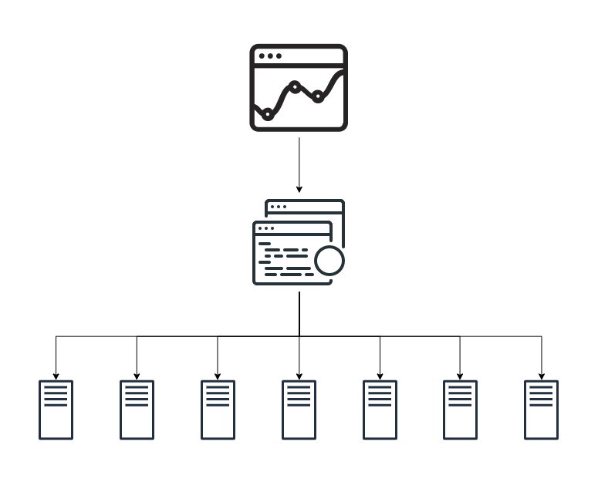
balance
Conventional Task Scheduling Algorithm

Slide 4
Multi-cloud Task Scheduling
The ability to schedule a compute task across multiple cloud providers.
Federate resources to act like a single unit.
Optimize for both cost and runtime.
Use measured performance instead of reported performance.

Slide 5
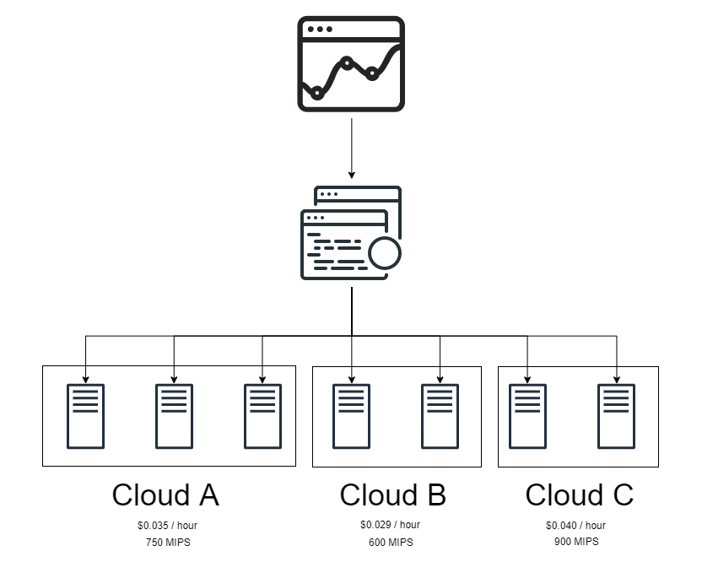
balance
Multi-Cloud Scheduling Algorithm

Slide 6
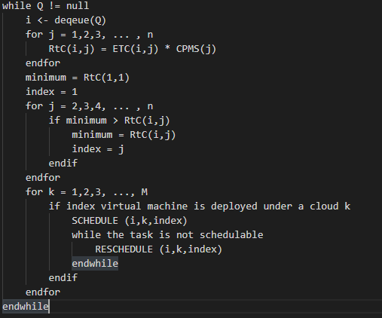
Proposed Algorithm
Q = Global Queue n = number of VMs across all clouds ETC(i,j) = expected runtime of task i on vm j CPMS(j) = Cost per ms of VM j M = total # of clouds

Slide 7
State-of-the-art
Round Robin (RR)
Modified Round Robin (MRR) ^{[1]}
MaxMin
MinMin
First Come First Serve (FCFS)
Monte Carlo Tree (MCT)
Particle Swarm Optimization (PSO)
[1] Khurma, R., Al Harahsheh, H. and Sharieh, A. (2018). Task Scheduling Algorithm in Cloud Computing Based on Modified Round Robin Algorithm. Journal of Theoretical and Applied information Technology, 96(17), pp.5869-5888.

Slide 8
Experimental settings
CloudSim set up to simulate cloud federation.
Three instances with 200 cloudlets each.
Practical testing will use machines on their respective clouds.
Cloud 1 : (2X) Google Cloud n1-standard-1 (1 vCPU, 3.75GB RAM) Cloud 2 : (2X) AWS a1.medium (1 vCPU, 2GB RAM) Cloud 3 : (2X) Azure DS1 v2 (2 vCPU, 3.5GB RAM)

Slide 9


Slide 10
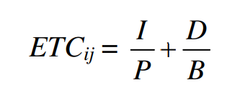
Execution Time
ETC_{ij} is the Execution time required to run task i on VM j
Let T_{i} = {I,D} denote the i^{th} task with the set of instruction I in MI and data D in Mb Let V_{j} = {P,B} denote the j^{th} virtual machine with the processing speed P in MIPS and bandwidth B in Mbps
Notes:
Panda, Sanjaya K., et al. “Allocation-Aware Task Scheduling for Heterogeneous Multi-Cloud Systems.” Procedia Computer Science, vol. 50, 2015, pp. 176–184., doi:10.1016/j.procs.2015.04.081.

Slide 11
Score Formula
RtC = ETC_{ji} / CPMS_{j} Let CPMS_{j} denote the cost/ms of of the VM j
Jobs to run | CPMS_{j} | ETC_{ji} | Cost Formula
500 | 0.00003 | 0.034 | 1133
500 | 0.0005 | 0.034 | 68
500 | 0.1 | 0.034 | 2.94

Slide 12
Theoretical Limitations
Accurately measuring performance.
Updating for changing cost models on the fly.
Interfacing with new clouds or changing cloud APIs.
Measuring task requirements.

Slide 13
Benefits to multi-cloud scheduling
Redundancy.
Higher performance to cost ratio.
Larger set of hardware available for different requirements.
Lower barrier to entry for multi-cloud.

Slide 14
Existing Work
Lin, Weiwei, et al. “Bandwidth-Aware Divisible Task Scheduling for Cloud Computing.” Software: Practice and Experience, vol. 44, no. 2, 2012, pp. 163–174., doi:10.1002/spe.2163.
Panda, Sanjaya K., et al. “Allocation-Aware Task Scheduling for Heterogeneous Multi-Cloud Systems.” Procedia Computer Science, vol. 50, 2015, pp. 176–184., doi:10.1016/j.procs.2015.04.081.
Panda, Sanjaya Kumar, et al. “Fairness-Aware Task Allocation for Heterogeneous Multi-Cloud Systems.” Advances in Systems Analysis, Software Engineering, and High Performance Computing Advanced Research on Cloud Computing Design and Applications, 2015, pp. 147–170., doi:10.4018/978-1-4666-8676-2.ch011.

